Slide 1
Defensive Security Project
by: Team 9

Slide 2
Table of Contents
This presentation contains the following resources:
Monitoring Environment
Attack Analysis
Project Summary & Future Mitigations

Slide 3

Monitoring Environment
‹#›

Slide 4
Scenario
As an SOC Analysts at VSI, our role is crucial in safeguarding our business from potential threats. Recent intelligence suggests that JobeCorp, a competitor, may resort to cyberattacks to disrupt our business. It’s our job to check the validity of these reports and mitigate any potential attacks.

Slide 5
[“Add-On” App]
‹#›

Slide 6
Website Monitoring
The Website Monitoring Add-On App is a powerful tool developed for Splunk that lets users monitor the availability and performance of websites in real-time. It's designed to provide visibility into website health and help troubleshoot performance issues. Also allows alerts for users when the monitored pages are changed.

Slide 7
Website Monitoring
Website monitoring can continually monitor the status and performance of VSI's webpage and/or servers, alerting us if any downtime or performance degradation occurs. This is vital to implement due to the nature of our business, downtime means loss of services which in turn means loss of money.

Slide 8
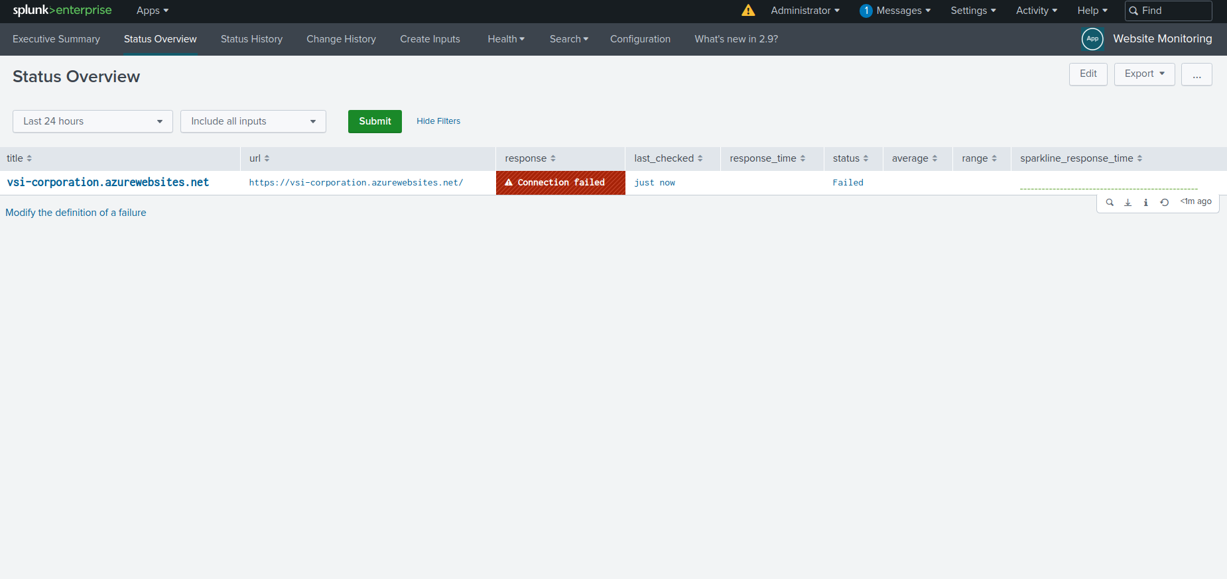
Website Monitoring Screenshot

Slide 9
Logs Analyzed
Windows Logs
Apache Logs
1
2
Event ID: Identifies the event type.
Source: The software/service that logged the event.
Time and Date: When the event was logged.
User: The local or network user who triggered the event.
Computer: The system on which the event occurred.
Client IP Address: The IP address of the client making the request.
Timestamp: The date and time when the request was received.
Request Line: Details of the request method, URL, and HTTP protocol.
Status Code: Indicates the server's response.
Size of the Object Returned: Useful for identifying potential issues or attacks.
User Agent: Information about the client's browser and operating system.

Slide 10
Windows Logs
‹#›

Slide 11
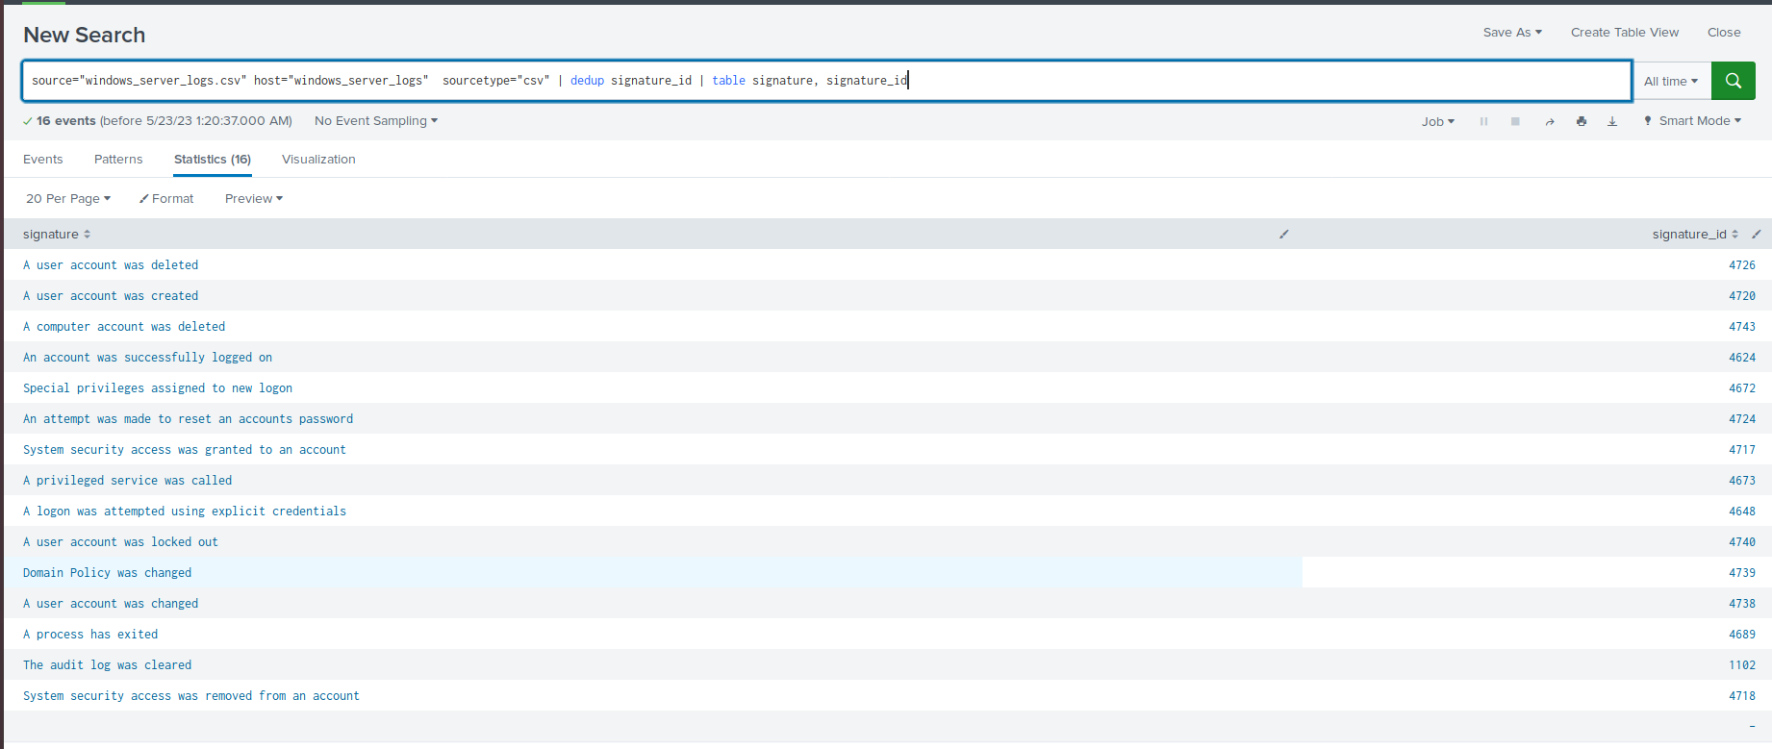
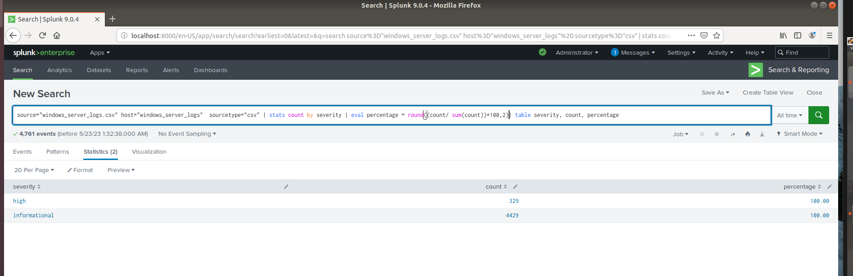
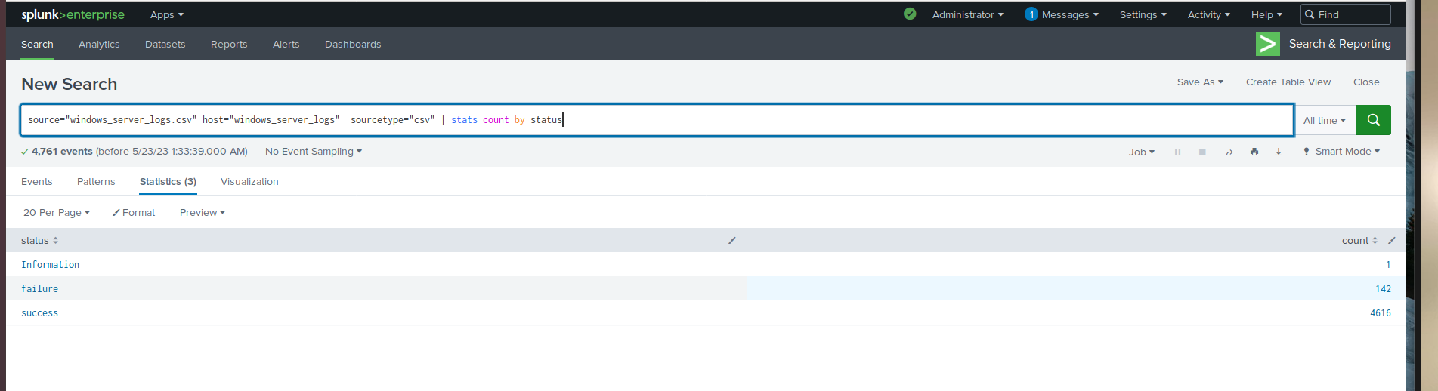
Images of Reports—Windows
Report Image
Report Image
Report Image

Slide 12
Attack Summary—Windows
Summarize your findings from your reports when analyzing the attack logs.
Severity Analysis:
Detected suspicious changes in severity cases.
High severity cases increased significantly from 329 to 1111.
Further investigation needed to identify the cause of this spike in high severity cases.
Failed Activities Analysis:
No suspicious changes identified in failed activities.
Decreased from 142 to 93, indicating a positive trend.
However, continuous monitoring is essential to ensure sustained improvement in this area.

Slide 13
Alerts—Windows
Designed the following alerts:
Alert Name | Alert Description | Alert Baseline | Alert Threshold
Failed Windows Activity | Alert for level of failed windows activity | 8 | 15
JUSTIFICATION: The average number of failed windows activity was about 7-8. So we set our threshold at 15 because we felt it was a good number to avoid alert fatigue. When the attack happened the alert was triggered.

Slide 14
Alerts—Windows
Designed the following alerts:
Alert Name | Alert Description | Alert Baseline | Alert Threshold
Successful Logins | Alert for the signature “an account was successfully logged on.” | 12 | 20
JUSTIFICATION: It serves as a key measure, identifying unusual login patterns that might indicate potential cyber threats like unauthorized access or brute force attacks, hence prompting immediate investigation.

Slide 15
Alerts—Windows
Designed the following alerts:
Alert Name | Alert Description | Alert Baseline | Alert Threshold
User Account Deleted | Alert for the signautre “a user account was deleted” | 10 | 20
JUSTIFICATION: There was an average of 10 user accounts deleted per hour. The highest was 19 in one hour. We set our Threshold to 20 based on those numbers to avoid missing potential threats.

Slide 16
Attack Summary-Windows
Summarize your findings from your alerts when analyzing the attack logs. Were the thresholds correct?
Failed Windows Activity
Suspicious volume of failed activity detected.
Count of events during the occurrence: 35 events.
Occurrence time: 8 AM.
Alert triggered for this activity.
No change in the threshold as it alerted during the attack and remained silent during non-attack periods.
Successful Logins
Suspicious volume of successful logins detected on three occasions.
Count of events during the occurrences: 1-2 AM (94 events), 8-9 AM (70 events), 9-10 AM (54 events).
Primary user logging in: User H.
Occurrence times: 1-2 AM, 8-9 AM, 9-10 AM.
Alert triggered for this activity.
No change in the threshold as the alert triggered at the correct time.
Deleted Accounts
No suspicious volume of deleted accounts detected.
Total decrease in events from 318 to 131.

Slide 17
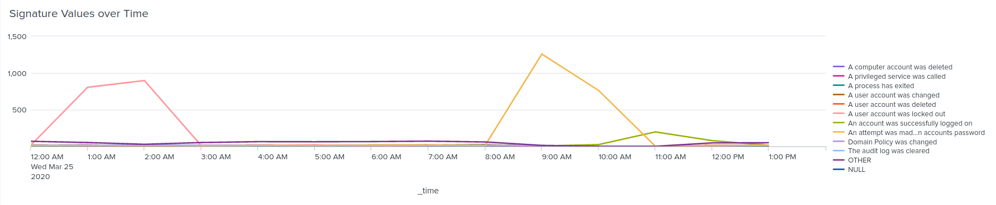
Dashboards—Windows

Slide 18
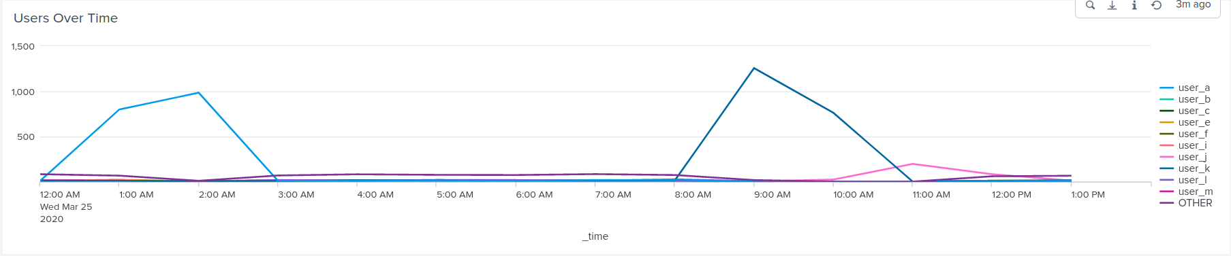
Dashboards—Windows

Slide 19
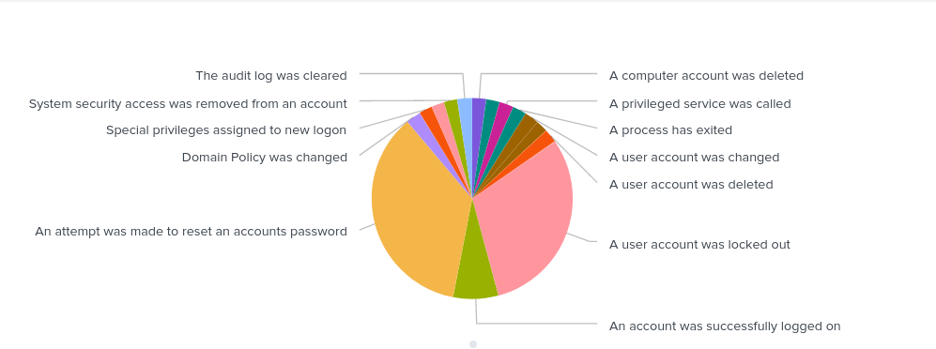
Dashboards—Windows

Slide 20
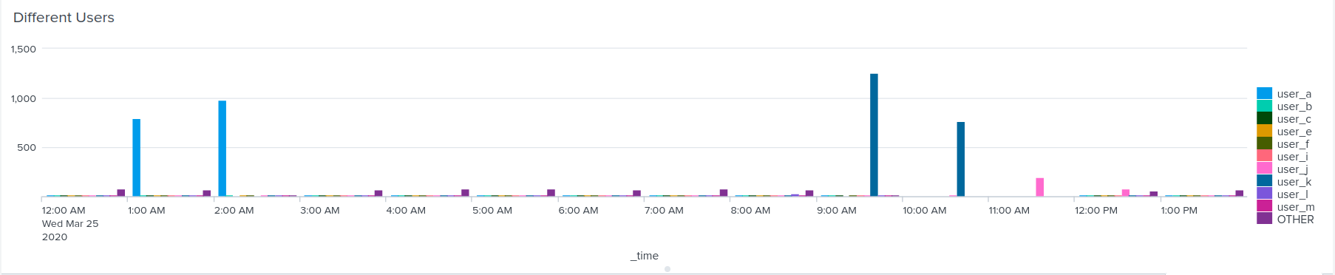
Dashboards—Windows

Slide 21
Attack Summary—Windows
Summarize your findings from your dashboards when analyzing the attack logs.
Dashboard Analysis for Time Chart of Signatures
Suspicious Findings:
Two instances of a user account being locked out had extremely high counts.
An attempt to reset a user account's password was detected at an unusual time.
Key Signatures:
User account locked out: Peak count of 896, occurred from 12 AM to 3 AM.
Attempt to reset account password: Peak count of 1258, occurred from 8 AM to 11 AM.
Dashboard Analysis for Users
Suspicious Findings:
Two users showed significant peaks in activity.
Key Users:
User A: Peak count of 984, active from 12 AM to 3 AM.
User K: Peak count of 1256, active from 8 AM to 11 AM.
User J: Peak count of 196, active from 11 AM.
Dashboard Analysis for Signatures with Bar, Graph, and Pie Charts
Suspicious Findings:
Reinforces the findings from the previous visualizations.
Dashboard Analysis for Users with Bar, Graph, and Pie Charts
Suspicious Findings:
Reinforces the findings from the previous visualizations.
Dashboard Analysis for Users with Statistical Charts
Advantages:
Easy identification of event peaks and potential attack signatures.
Disadvantages:
Only represents the most significant peaks and events in detail.

Slide 22
Apache Logs
‹#›

Slide 23
Reports—Apache
Designed the following reports:
Report Name | Report Description
HTTP Methods | Report of total HTTP Methods
HTTP Response Codes | Report of HTTP Response Codes
Top 10 Referrer Domains | Report of Top 10 Referrer Domains
Activity outside US | Report of Activity outside of the US

Slide 24
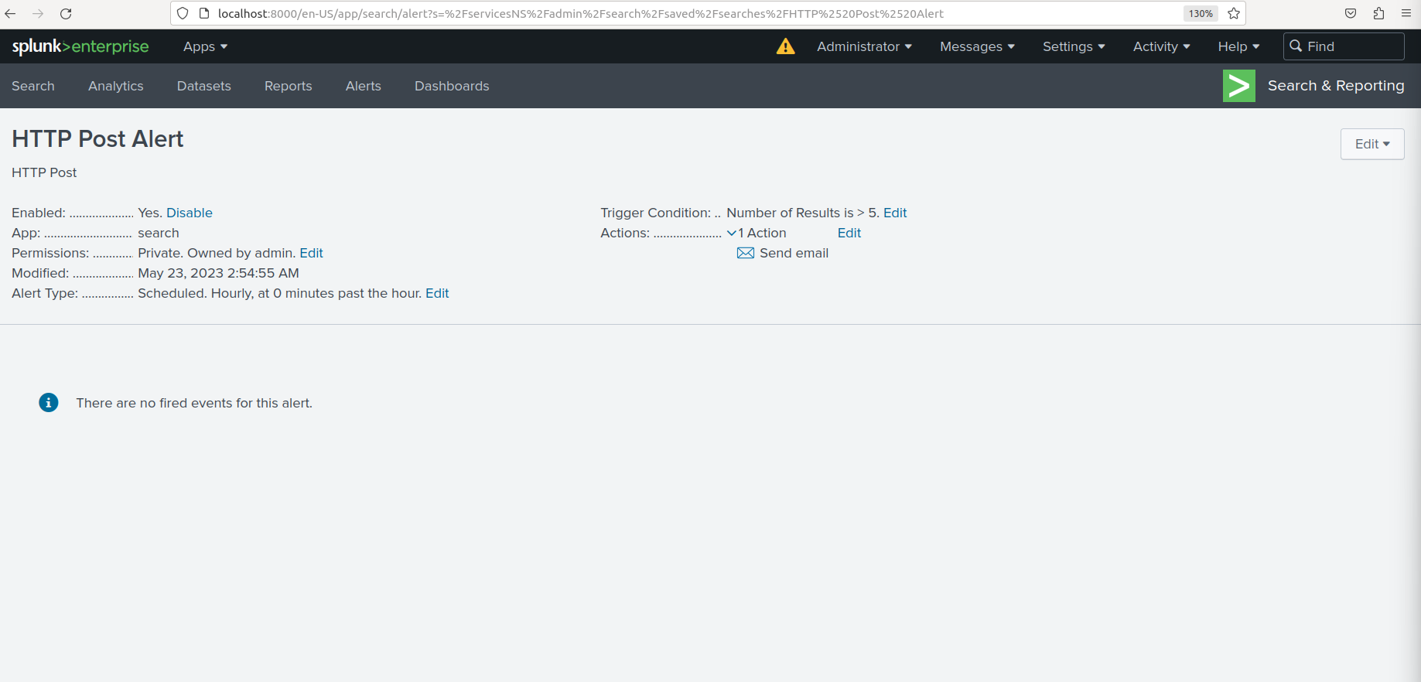
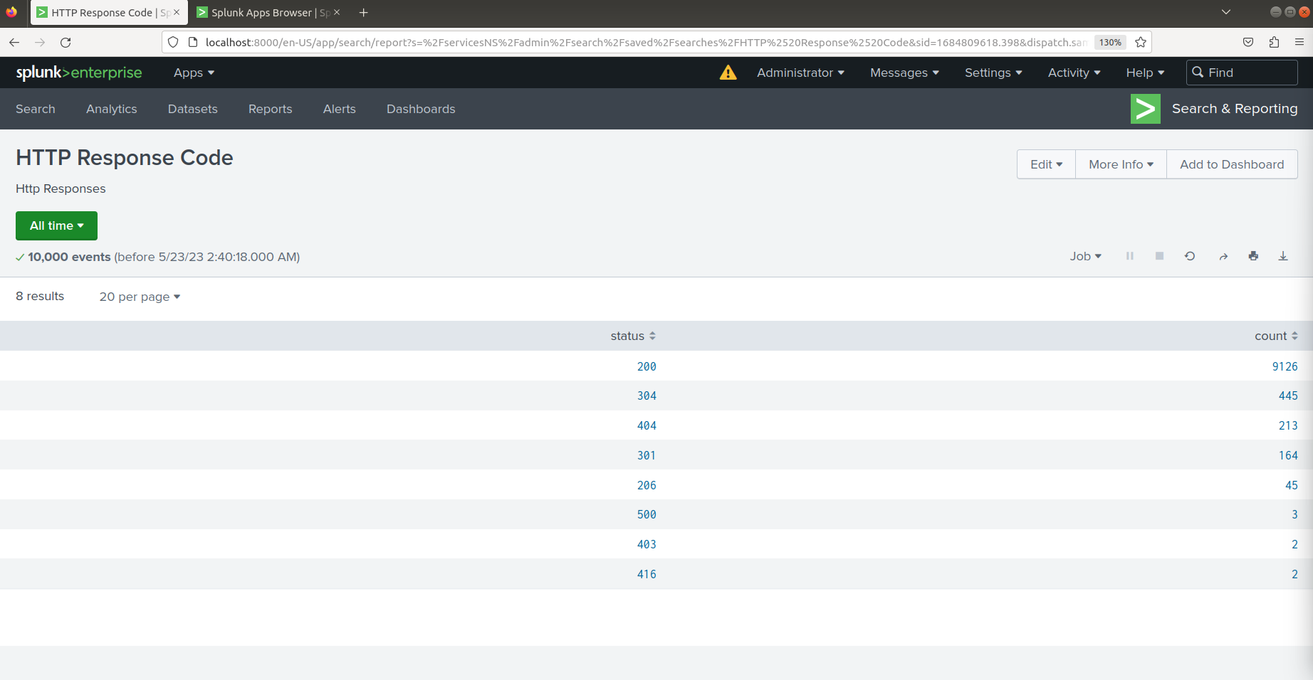
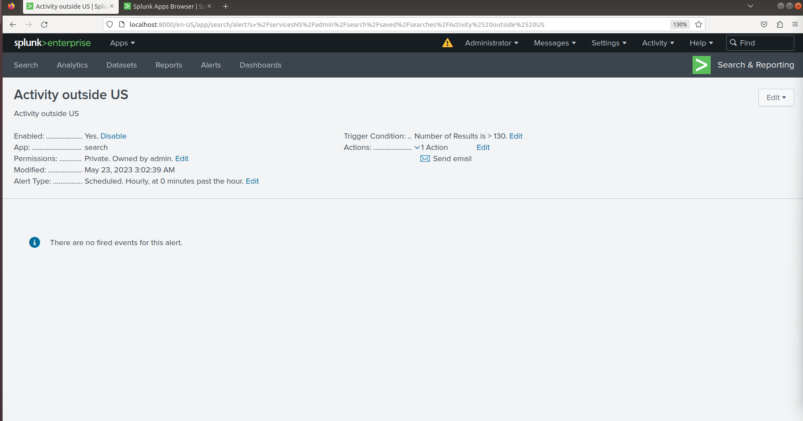
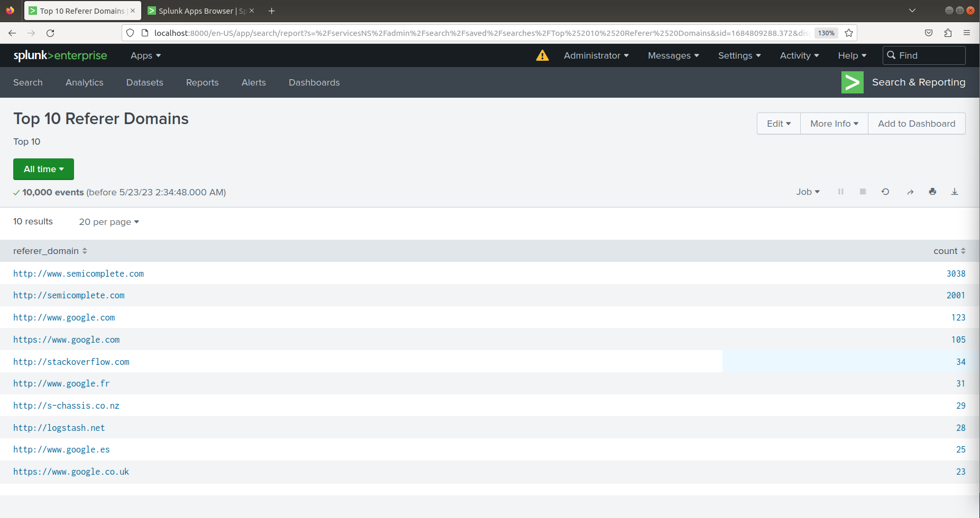
Images of Reports—Apache

Slide 25
Attack Summary—Apache
Summarize your findings from your reports when analyzing the attack logs.
HTTP Methods Analysis
Detected an increase in the usage of the HTTP POST method from 106 to 1324.
HTTP POST is commonly used to send data to a server for processing or storage, often utilized for form submissions or resource creation.
Referrer Domains Analysis
No suspicious changes observed in referrer domains.
Total activity showed a decrease.
HTTP Response Codes Analysis
Detected a significant increase in the occurrence of response code 404 from 213 to 679.
Response code 404 typically indicates a resource not found error.

Slide 26
Alerts—Apache
Designed the following alerts:
Alert Name | Alert Description | Alert Baseline | Alert Threshold
HTTP Post alert | Alert for number of HTTP Post | 4 | 10
JUSTIFICATION: We set our threshold for 10 because the average number of Post alerts was around 3-4. The alert was triggered at the time of the attack.

Slide 27
Alerts—Apache
Designed the following alerts:
Alert Name | Alert Description | Alert Baseline | Alert Threshold
Activity outside US | Alert for excess activity outside of the US | 70-80 | 130
JUSTIFICATION: The average activity outside of the US was around 70-80 events with a high of 120 events. We set our threshold to 130 events to avoid alert fatigue.

Slide 28
Attack Summary—Apache
Summarize your findings from your alerts when analyzing the attack logs. Were the thresholds correct?
Alert Analysis for International Activity
Detected a suspicious volume of international activity.
Count of 939 events observed at 8 PM.
Alert triggered for this activity.
No change needed to the previously set threshold.
Alert Analysis for HTTP POST Activity
Detected a significant volume of HTTP POST activity.
Count of 1,296 events observed at 8 AM.
Alert triggered for this activity.
No change needed to the previously set threshold.
Key Takeaways
Both alerts successfully detected suspicious activity during the specified hours.
The alert thresholds were appropriate and triggered at the correct times.
Effective monitoring and analysis helped identify potential security threats and take appropriate actions.

Slide 29

Dashboards—Apache

Slide 30
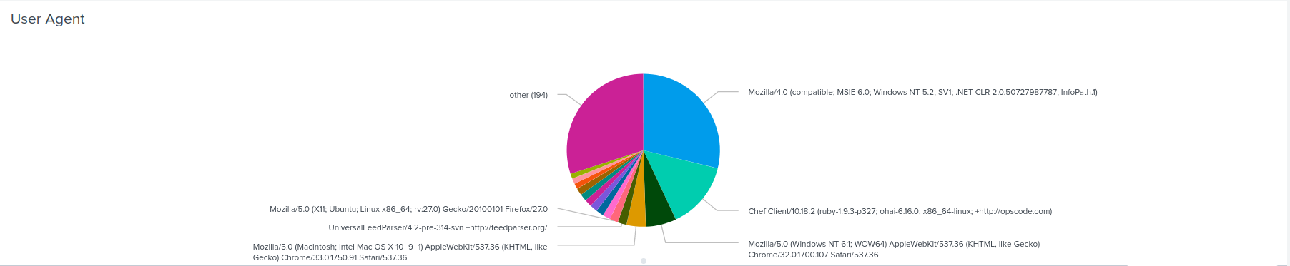
Dashboards—Apache

Slide 31
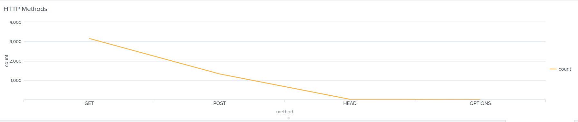
Dashboards—Apache

Slide 32
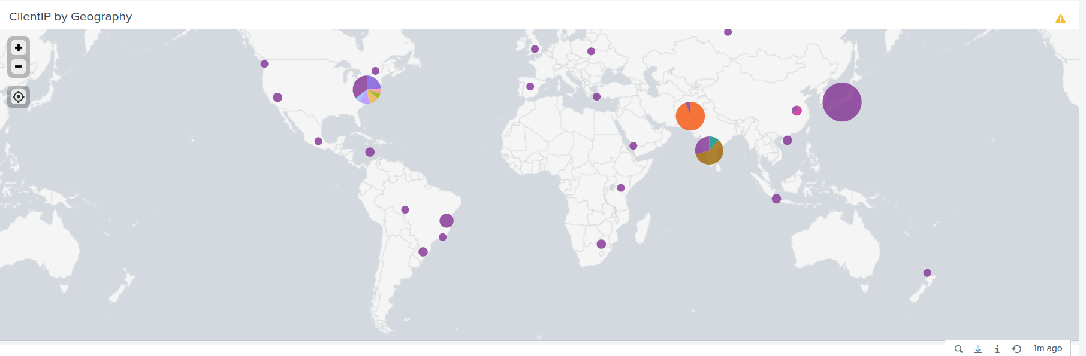
Dashboards—Apache

Slide 33

Dashboards—Apache

Slide 34
Attack Summary—Apache
Summarize your findings from your dashboards when analyzing the attack logs.
Cluster Map
Suspicious Finding: Two cities had activity over 400.
Location with High Volume of Activity: Kyiv and Kharkiv.
City Counts: Kyiv - 438, Kharkiv - 432.
URI Data
Suspicious Finding: High activity in Account Logins.
Most Accessed URI: /VSI_Account_logon.php.
Potential Attacker Activity: Brute Force Attack or Credential Stuffing.

Slide 35
Summary and Future Mitigations
‹#›

Slide 36
Project 3 Summary
What were your overall findings from the attack that took place?
Overall, the attack logs reveal a range of suspicious activities, including increased severity cases, failed and successful login attempts, suspicious user activity, and abnormal usage of HTTP methods. These findings indicate a targeted attack aimed at compromising system security, emphasizing the need for further investigation, continuous monitoring, and appropriate security measures to mitigate future risks.
To protect VSI from future attacks, what future mitigations would you recommend?
To mitigate future risks based on the attack logs, it’s recommended to enhance logging and monitoring capabilities, implement multi-factor authentication for user accounts. Conduct regular security assessments and training, develop an incident response plan, prioritize patch management and vulnerability remediation. These measures will enhance overall security posture, helping mitigate the potential impact of future attacks.

